Slide 1
Proven Strategies for
Fundraising in 2022

Slide 2
How To Plan for 2022 and Beyond
Strategic Plan
Sprint Strategies
Budget Formulation
You have to make your budget work
Charge more for events, find sponsorships, investment partners
2020 You hit your reserves
That is what reserves are for. The rainy day is here. The storm is here.
2021 Build momentum as a strong organization
2022 Rebuild your reserves

Slide 3
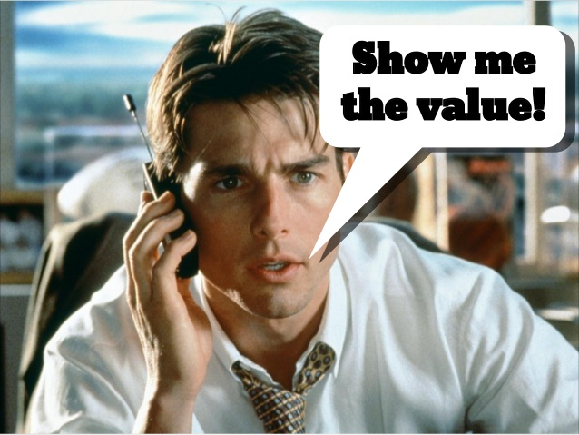
The Value of Your Organization
You need to define the value in order to raise funds
AGC: Tech schools and PPE
ACCC: legislative advocacy & magazine
CALCP: Essential businesses
CWMA: CDA continuing education
Leadership Academy or Master Class
Executive C-Level Summit: Management Track (AACE)
WHAT DOES THE HOME PAGE OF YOUR WEBSITE SAY?

Slide 4
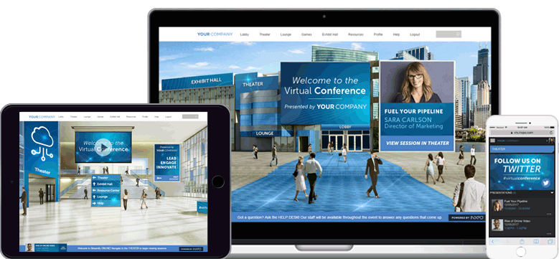
Virtual Platforms
Your affiliate members want/need to engage more than ever
Ask them how they want to engage
They can introduce a speaker at an event
Sponsor a program
Write an article for your website or newsletter
Make phone calls to members to check in
Ambassador Program
What is the goal of their engagement?
Brand awareness, new product, engagement, messaging to a broad/specific group

Slide 5
Sponsorship Dollars
Associations and their corporate colleagues have a
co-dependent relationship. Corporations provide associations with financial support, and in return, associations provide corporations with positive PR and a boost in business.
91%
61%
50%
of global consumers are likely to switch brands to one associated with a good cause, given comparable price and quality
of consumers are willing to try a new brand, or one they’ve never heard of, because of its association with a particular cause
of global consumers said they would be willing to reward companies that give back to society by paying more for their goods and services

Slide 6
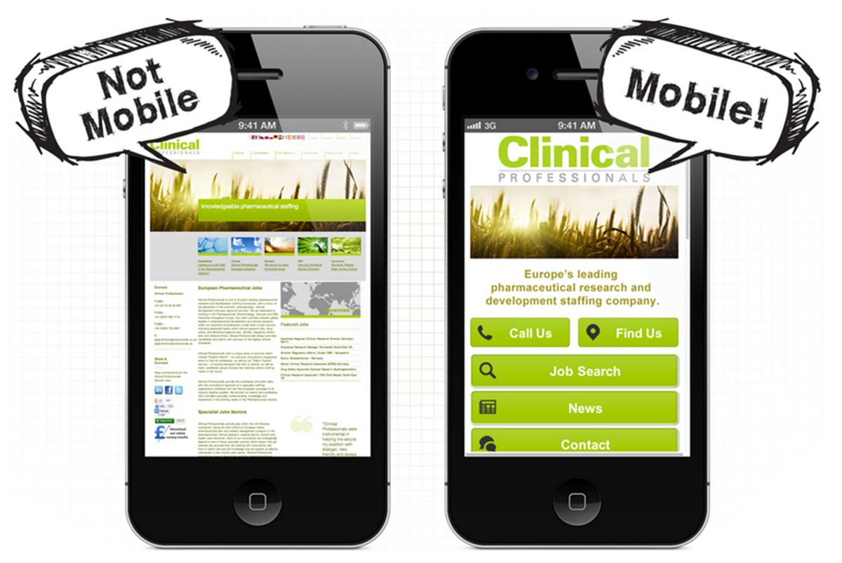
Make Sure Your Website Is Mobily Responsive
The vast vast majority of website visitors and donors are going to come to your website on their phone. Make sure your website looks good and works properly when they do!

Slide 7
Social Share Prompt
If you have the ability to do this, make sure there is an option for every donor to automatically share about their donation on Facebook, Twitter or Instagram.
This is known as a "social share prompt.”
People are way more likely to donate to a new cause when they hear about it from a friend. So spread the word about your organization in a much wider way by encouraging your donors to share about their donations right after they make them.
Most website builders have the ability to automatically offer donors the ability to share immediately on social media after they donate. You can customize the suggested post, upload a photo to share, and even be sure the link to your donation page is included in the social media post!

Slide 8
Enable Reoccurring Donations & Monthly Dues
Recurring donations are getting much more popular these days. Instead of giving you $50 during the holiday season, what if one of your donor's signed up to donate $10/month this year? That's more than 2x the typical holiday donation you would normally get.
Monthly dues (EFT if you can to avoid ACH) increases member retention

Slide 9
Brand Visibility
Corporate sponsors view sponsorship as a business arrangement – period.
Sponsorship is a strategy to build brand recognition and increase sales
They want their logo anywhere and everywhere
T-shirts, banners, signage, newsletters, print, web, social media, landing pages and email campaigns… just to name a few
Check out my virtual background

Slide 10
Sponsorship for Your Events
YOU HAVE TO ASK THEM
Some companies do have money right now
Watch other event programs
Look at the sponsor logos
If they have a limit, break up the payments
Hope House raised $405,000 on their virtual gala
We doubled our profit from our national conference at AACE compared to an in-person event

Slide 11
Sponsorship for Your Events
Grab the list of your members/area businesses and virtually visit or call them (have your leadership call them)
If you email them – DON’T MASS EMAIL
Include what problem you can solve for them with their sponsorship
Are you sending holiday messages to them
Give the Gift of Membership this Holiday Season

Slide 12
Metrics For Success
When a company sponsors an event, they want to measure their return on investment. The most common metrics used to measure sponsorship ROI is to evaluate the amount of exposure the sponsor received throughout the campaign.
Put together a comprehensive list of any marketing materials featuring their logo, and the number of impressions it received.
Give examples of other businesses (in the same industry – if possible) that have banner ads on your website and print the metrics of how many clicks that banner received.
Email blast | Sent on May 15 | 1,300 opens
Direct Mail | Mailed on May 20 | 1,000 recipients
Facebook Post | Posted on May 23 | 400 likes

Slide 13
Sponsorship for Your Events
Sell sponsor banners on event apps and online platforms
Put up full screen ads/videos before/after presentations
Sponsors to introduce speakers
Sponsors to engage in VIP sessions before/after speakers in a pre-selected breakout room
Overlay lower-third logos on presentations
Branded breakouts/billboards/chats
Sponsors host breakout sessions

Slide 14
Sponsorship for Your Events
Promote sponsors in spotlights via email (know the data/metrics of everything)
Your Sponsor/Investment Package is only a starting point
Listen to their pain points
Talk to them about their target clients – you may have an avenue to get them
It may not be logo placement – it may be a VIP event

Slide 15
Sponsorship for Your Events
Sponsored Breaks, Campfires, Speaker Q&A’s
Sponsor promo items mailed to attendees before/after a conference
Sponsor virtual swag bags (free registration to upcoming events, free webinar, etc.)
Sponsor home workouts, yoga, cooking class

Slide 16
Sponsor Testimonial
"I just must let you (and your whole team) know what a great job you all did on this 2020 AACE Virtual Conference!!! I have attended several virtual conferences during this crazy, COVID time we are all in and I want you to know your conference has been GREAT! The participation level, engagement from everyone, enthusiasm from speakers and attendees have been so enjoyable and it's been done without a glitch; no freezing of screens or interruptions has made learning a key component. After-all, that is why everyone is attending. The way you have structured this conference was well-thought out; from the classes to the vendor participation (which is important to us!) and I feel I/my organization will gain greatly from this. We would all like to be in person but that is not reality currently. I feel I was able to express myself and organization as if I was at my actual booth! AND I was able to see the speakers this year. Every in-person conference, I am stuck at my booth the entire time. Again- wonderful job to you and your team and we look forward to next year’s conference, either in person or virtual!"

Slide 17
Sponsorship for Your Events
Always deliver what you’ve promised
Start the relationship before you ask for money
Nurture and build the relationship
Stop by their place of business throughout the year
Draw up a calendar of touch points
The point is to listen, listen, listen… and really care
Create a contract that details all the deliverables and lays out exactly where the sponsor can anticipate visibility. Put together a comprehensive list of any marketing materials featuring their logo, and the number of impressions it received.

Slide 18
Say Thank You Often
Thank you card
Welcome Packet with promotional items
Spotlights, blogs, website recognition
Video Thank You’s
Give them a VIP party
With a much-sought-after guest
Send a Popcorn Bucket: Popping by to see you
Someone can sponsor the popcorn and logo the box
Other themes
Send Sponsor Anniversary Cards

Slide 19
Sponsor Ideas (in-person but wanted to share)
Sponsor the charging station
$2500 sponsor level Your cost $40
Coffee Sponsor
Breakfast Sponsor
VIP Reception Sponsor
Table Sponsors
Room Sponsors
Chairman’s Circle Sponsors
Large Employer Sponsor
Perfect Parking Spot Sponsor
Post-Its on the mirrors in conference attendee rooms
Ice luge with Sponsor Logo
Presenting Sponsor logo on a wall made of orchids
Does the event venue have a pool? An inflatable logo
Have a band at your event? Logo the drum kit
Video Facebook Cover
Games lounge Sponsor
Branded promoters at events
Give your largest sponsors mike time
Sponsors introduce speakers
Stair clings at events that showcase your sponsor logo
Signature cocktails named after your sponsors
Create a “leaderboard” banner stand that you can take to all of your events with your sponsor logos
Allow sponsors to ask their target audience a question in your event follow up surveys
Naming Rights
Creative Sponsor Matching Opportunities
Fitness Room Sponsor at large events
Brand your staff with your sponsor logos at the receptions (their shirts)
Photo booth with Sponsor logo on the pictures or frames

Slide 20
Thank you!
Dot Miller, CAE
CEO
The Solution
dot@thesolutionwebsite.com
cell: 303-885-2501
www.thesolutionwebsite.com
Let’s connect!
https://www.linkedin.com/in/dot-miller/
https://www.facebook.com/dot.batcheldermiller

